Slide 1
SKILLS AND JOB REOMMENDER
BATCH ID:
PNT2022TMID30095
TEAM LEADER
G.RENUKA DEVI (610819205040)
TEAM MEMBERS
PRITAM TIWARI (610819205039)
S SANDHIYA (610819205042)
S SANGEEETHA (610819205045)
I SOWMIYA (610819205048)
GUIDED BY:J INDUMATHI ,AP/(IT)
MENTOR:A RICHARD WILLIAM ,AP/(IT)
Er. Perumal Manimekalai College Of Engineering, Hosur

Slide 2
CONTENTS
ABSTRACT
INTRODUCTION
LITERATURE REVIEW
REFERENCES
B.Tech(IT)

Slide 3
ABSTRACT
In the last years, job recommender systems have become popular since they successfully reduce information overload by generating personalized job suggestions. Although in the literature exists a variety of techniques and strategies used as part of job recommender systems, most of them fail to recommending job vacancies that ﬁt properly to the jobseekers proﬁles. Thus, the contributions of this work are threefold, we:
i) made publicly available a new dataset formed by a set of job seekers proﬁles and a set of job vacancies collected from diﬀerent job search engine sites;
ii) put forward the proposal of a framework for job recommendation based on professional skills of job seekers;
iii) carried out an evaluation to quantify empirically the recommendation abilities of two state-of-the-art methods, considering diﬀerent conﬁgurations within the proposed framework.
We thus present a general panorama of job recommendation task aiming to facilitate research and real-world application design regarding this important issue Keywords: Job matching, job seeking, job search, job recommender systems, person-job ﬁt, LinkedIn, word embedding
Keywords: Job matching, job seeking, job search, job recommender systems, person-job ﬁt, LinkedIn, word embedding

Slide 4
INTRODUCTION
The fast growth of the Internet caused a matching growth of the amount of available online information that increased the need to expand the ability of users to manage all this information. This encourages a substantial interest in specific research fields and technologies that could benefit the managing of this information overload. The most important fields are Information retrieval and Information filtering. Information retrieval deals with automatically matching users information and Information filtering aims to assist users eliminating unwanted information
Recommender systems are being broadly accepted in various applications to suggest products, services, and information items to latent customers. Many e-commerce applications join recommender systems in order to expand customer services

Slide 5
The Internet-based recruiting platforms become a primary recruitment channel in most companies. While such platforms decrease the recruitment time and advertisement cost, they suffer from an inappropriateness of traditional information retrieval techniques like the Boolean search methods Consequently, a vast amount of candidates missed the opportunity of recruiting. The recommender system technology aims to help users in finding items that match their personnel interests; it has a successful usage in e-commerce applications to deal with problems related to information overload efficiently
LITERATURE REVIEW
A survey of job recommender systems
Shaha T Al-Otaibi and Mourad Ykhlef 29.7.(2012)

Slide 6
LITERATURE REVIEW
Linking Person-job Fit to Job Stress: The Mediating Eﬀect of
Perceived Person-organization Fit
N Deniz, A Noyan, and O G Ertosun
20.7.(2015)
The study also aims to investigate if perceived person-organization fit mediates the relationship between person-job fit and job stress. The results of the study demonstrate that paying careful attention to person-job fit and adjusting employees to the organization are essential factors for decreasing job stress
The research indicates that organizations whose employees are suited to their jobs operate with greater efficiency and adapt to change more smoothly than those whose employees do not fit their jobs.

Slide 7
LITERATURE REVIEW
Taxonomy-based job recommender systems on Facebook and LinkedIn proﬁles
M Diaby and E Viennet (2014)
The Global Leader in Social and Mobile Recruiting that offers Facebook recruitment solutions; to use its applications, Facebook or LinkedIn users explicitly grant access to some parts of their data, and they are presented with the jobs whose descriptions are matching their profiles the most
A taxonomy that defines the set of occupations across the world of work, to develop a new taxonomy-based vector model for social network users and job descriptions suited to the task of job recommendation; we propose two similarity functions based on the AND and OR fuzzy logic's operators, suited to the proposed vector model

Slide 8

The recommender systems could use historical rating information to determine which type of job required which type of candidate characteristics in the past in order to be rated positively by the recruiter. This information could then be used to predict the match between job and previously not rated candidates. The need of applying the recommender system techniques for selection process can be motivated from different perspectives. While we interested in how people find an appropriate job, other researchers are interested in how change the ways people effectively collaborate once the candidate is recruited. This increases the requirements to select candidates that not only fit with the requirements of the job but also with the team members in terms of interpersonal compatibility
MOTIVATION OFJOB REOMMENDATION

Slide 9
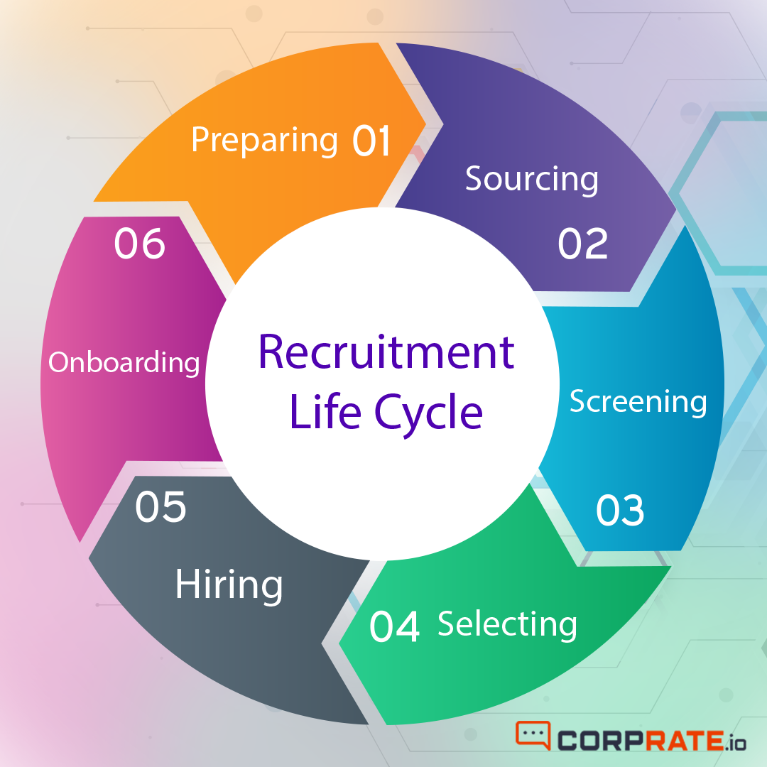
THE RECRUITING PROCESS
The recruiters generate the job description by determining the set of requirements and constraints on skills, expertise levels, and degrees
Recruiting process is a core function of human resource management treating the labour as one of the important factors of production

Slide 10
SYSTEM APPROACHES
COLLABORATIVE FILTERING
CHARATERISTICS
-Model-based methods are expensive model building
-Independent of any machine-readable representation of the recommended objects
-Work well with complex objects such as sounds and movies
-Domain knowledge not needed.– Quality improves over time.
CHALLENGES
-Ramp-up problems for new users and items
-Performance decreased when user-item matrix become large.– Limited scalability for large data.

Slide 11
CONTENT-BASED FILTERING
CHARATERISTICS
CHALLENGES
-Domain knowledge not needed.
-Work well with implicit feedback when explicit rating is difficult.
-Quality improves over time.
-Performance limited by the features that associated with recommended objects.
- Venus has a beautiful name and is the second planet from the Sun

Slide 12
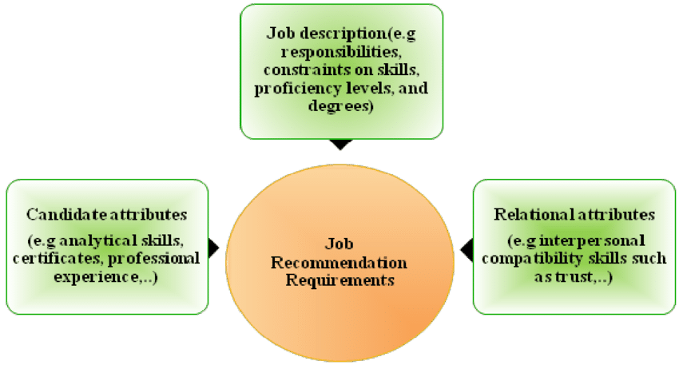
JOB REQUIREMENTS
Recommendations should be based on the candidate attributes, as well as the relational aspects that determine the fit between the person and the team members with
whom the person will be collaborated.

Slide 13
REFERENCES
Shaha T Al-Otaibi and Mourad Ykhlef. “A survey of job recommender systems”. In: International
Journal of the Physical Sciences 7.29 (2012), pp. 5127–5142. issn: 19921950. doi:10.5897/IJPS12.482.
N Deniz, A Noyan, and O G Ertosun. “Linking Person-job Fit to Job Stress: The Mediating Eﬀect of
Perceived Person-organization Fit”. In: Procedia - Social and Behavioral Sciences 20.7.(2015), pp. 369–376

Slide 14
M Diaby and E Viennet. “Taxonomy-based job recommender systems on Facebook and LinkedIn proﬁles”. In: Proc. of Int. Conf. on Research Challenges in Information Science (2014), pp. 1–6. issn: 21511357. doi:10.1109/RCIS.2014.6861048.
M Kusner et al. “From word embeddings to document distances”. In: Proc. of the 32nd Int. Conf. on Machine Learning, ICML’15. 2015, pp. 957–966
M Diaby, E Viennet, and T Launay. “Toward the next generation of recruitment tools:An online social network-based job recommender system”. In: Proc. of the 2013 IEEE/ACM Int. Conf. on
Advances in Social Networks Analysis and Mining, ASONAM 2013 (2013) pp.
821–828. doi:10. 1145/2492517.2500266

Slide 15

THANK YOU

